Slide 1
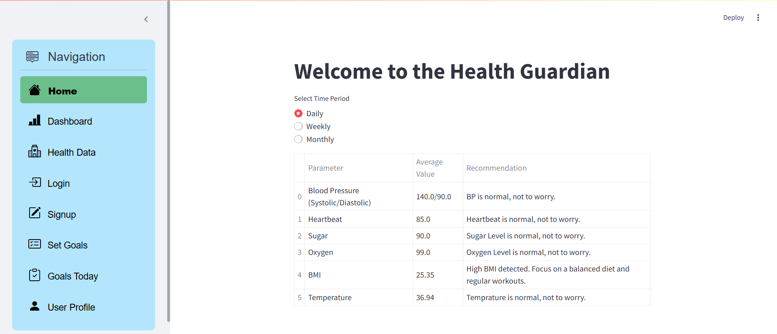
HealthGuardian
Smart Health Tracker for Monitoring Health
By Yash Parekh

Slide 2
CONTENTS
Introduction
Features
Technologies Used
Working
Benefits
Future Enhancements
Conclusion

Slide 3
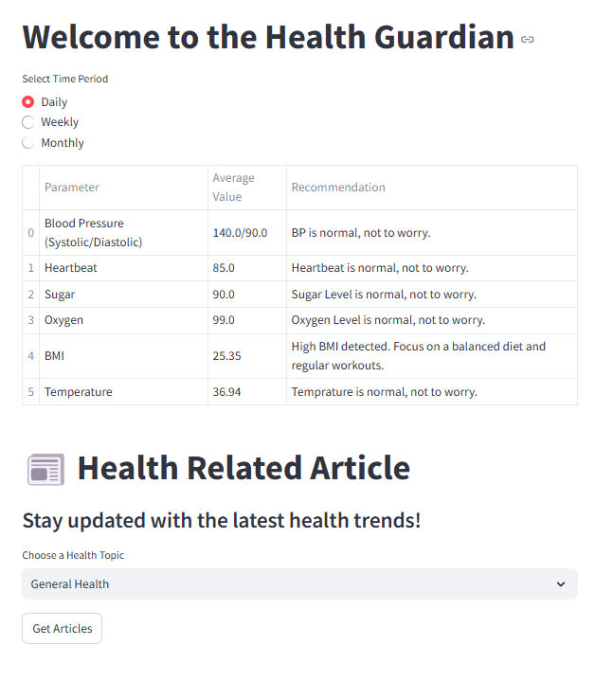
INTRODUCTION
HealthGuardian is a simple and smart health tracking app. It helps users log and monitor their daily health data, like blood pressure, heartbeat, sugar levels, oxygen, weight, and temperature.
The app shows easy-to-read charts for daily, weekly, and monthly trends, making it easier to track health changes. Built with Python, Streamlit, and MySQL.

Slide 4
Features
User Authentication & Profile Management
Daily Health Data Logging
Health Data Visualization
Goal Tracking & Achievements
BMI Calculation & Health Recommendations
Data Storage & Security
User-Friendly Interface

Slide 5
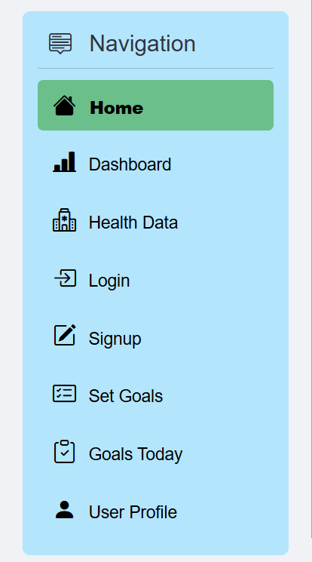
Technology Used
Python
Python is the core programming language used in HealthGuardian and it’s libraries like numpy, matplotlib and pandas.
Used for data processing, calculations, and backend logic.
Streamlit
Streamlit is used for building the frontend interface of HealthGuardian.
It allows easy development of interactive web applications with minimal coding and creating a clean and user-friendly UI.
MySQL
MySQL is used as the database to store user profiles, health records and goals tracking. It ensures data persistence, security, and efficient retrieval of health information.

Slide 6
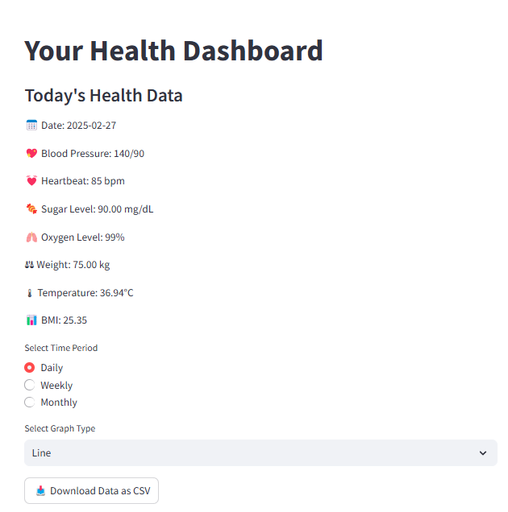
Working
User can easily sign up through SignUp page by giving basic details containing email, password, name, age, gender, height, birthdate and blood group. And after successfully signing up, user can login and access the app.
Now user will able to see and edit his profile and can load his daily health data and also see the weekly and monthly data, and can export report of health data.
User will get recommendations based on provided health data and our analysis and also able to generate the health articles and can set the daily goals and also track them.

Slide 7
FUTURE ENHANCEMENTS
Wearable Device Integration – Sync data from smartwatches and fitness bands for real-time tracking.
Personalized Health Tips – Provide AI-driven diet and exercise recommendations.
Doctor Consultation Feature – Enable in-app virtual consultations with healthcare professionals.
Automated Reminders & Alerts – Notify users about medication, check-ups, and health milestones.
Mobile App Development – Expand accessibility with a dedicated mobile application.

Slide 8
Conclusion
HealthGuardian is a smart and user-friendly health tracking system designed to help users monitor their daily health metrics effortlessly. By integrating Python, Streamlit, and MySQL, it provides real-time data visualization, goal tracking, and personalized insights. The platform enhances health awareness, encourages preventive care, and supports users in maintaining a healthy lifestyle. With future advancements like AI-driven predictions, wearable integrations, and mobile app expansion, HealthGuardian aims to become a comprehensive digital health companion.

Slide 9
THANK YOU

